Slide 1

Computer Science and Engineering
TY BTech Trimester-VII
Disclaimer:
Information included in these slides came from multiple sources. We have tried our best to cite the sources. Please refer to the references to learn about the sources, when applicable.
The slides should be used only for preparing notes, academic purposes (e.g. in teaching a class), and should not be used for commercial purposes.

Slide 2
Unit 2: NETWORK LAYER
Network Layer Design Issues
Switching Techniques
Protocol: IPv4 and IPv6 addressing schemes

Slide 3
Functionality of Network Layer
Implements routing of frames (packets) through the network.
Defines the most optimum path the packet should take from the source to the destination.
Defines logical addressing so that any endpoint can be identified.
Handles congestion in the network.
Facilitates interconnection between heterogeneous networks (Internetworking).
The network layer also defines how to fragment a packet into smaller packets to accommodate different media

Slide 4
Network Layer Design Issues
Store-and-Forward Packet Switching
Services Provided to the Transport Layer
Implementation of Connectionless Service
Implementation of Connection-Oriented Service
Virtual-Circuit and Datagram Subnets

Slide 5
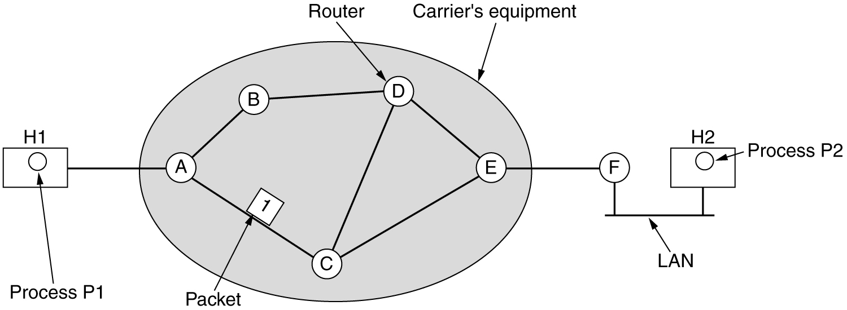
Store-and-Forward Packet Switching
Environment of network layer protocols

Slide 6
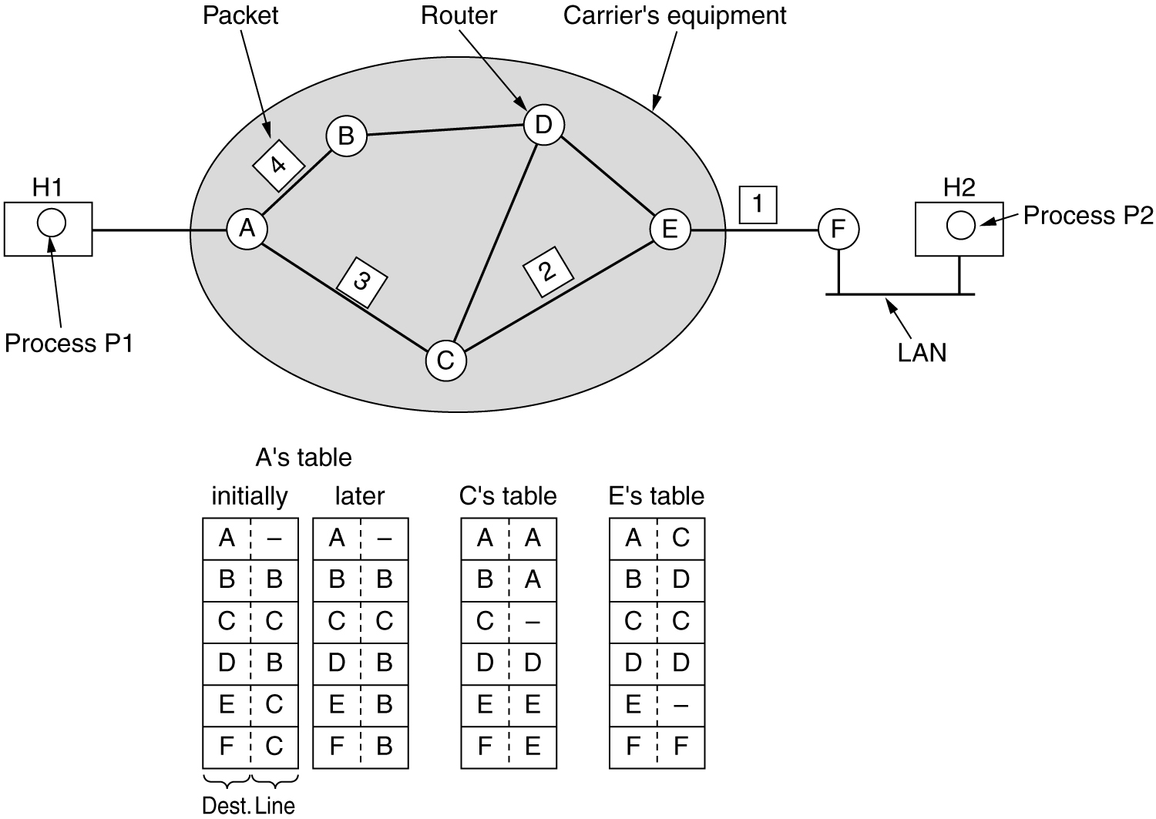
Implementation of Connectionless Service
Routing within a diagram subnet

Slide 7
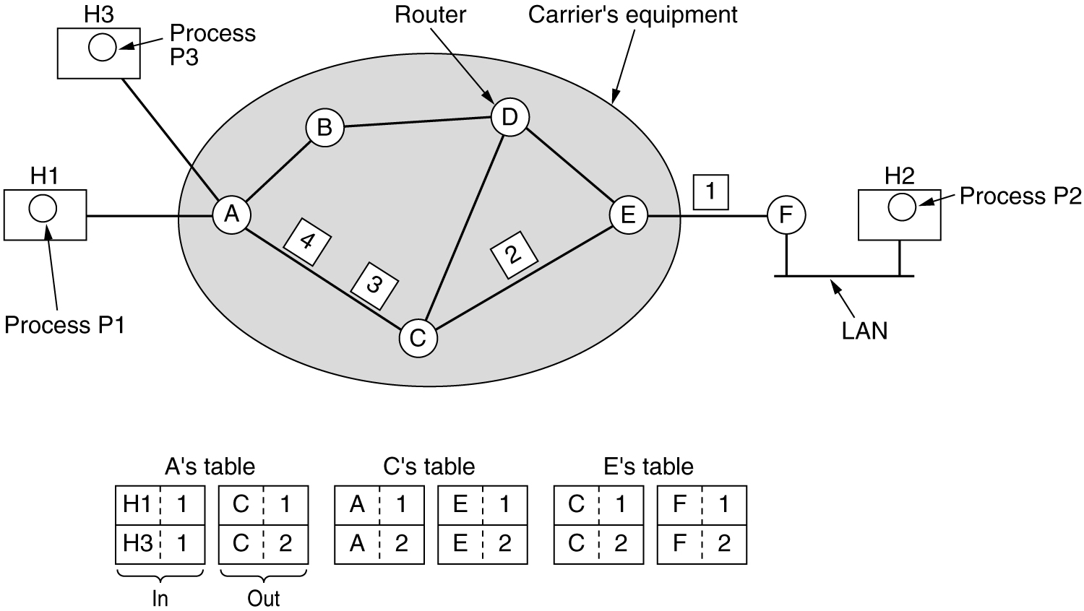
Implementation of Connection-Oriented Service
Routing within a virtual-circuit subnet

Slide 8
Virtual Circuit
Datagram

Slide 9
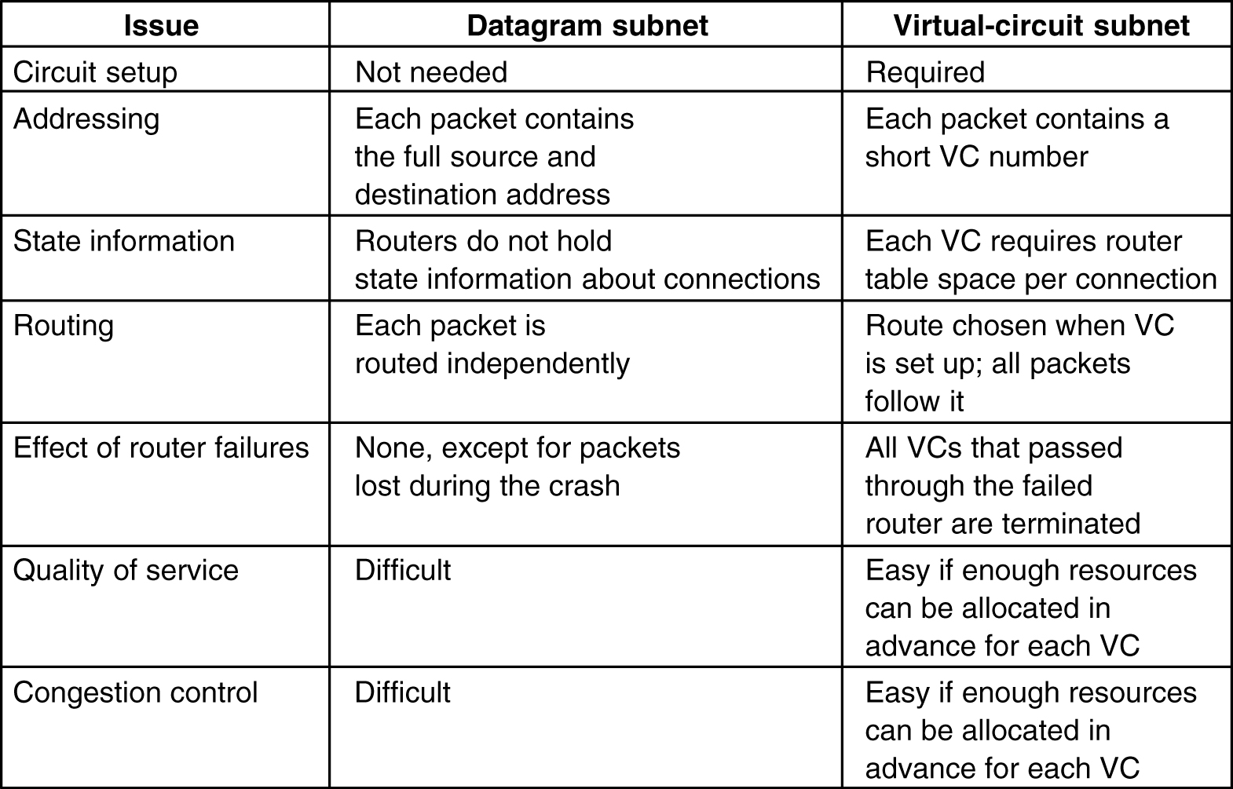
Comparison of Virtual-Circuit and Datagram Subnets
5-4

Slide 10
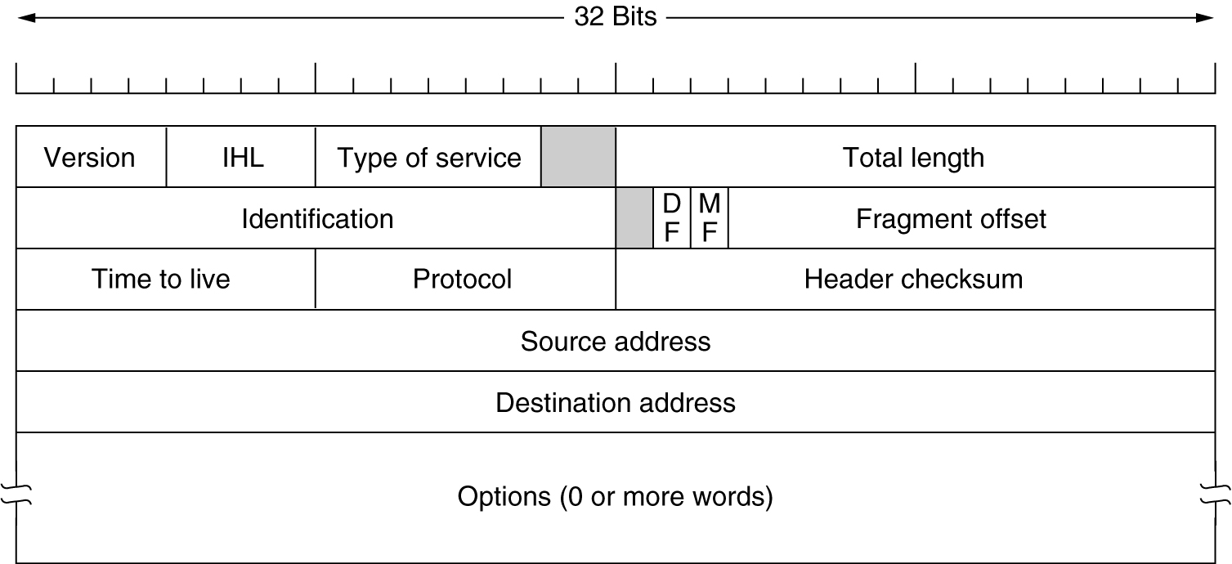
Internet Protocol: IPv4
The IPv4 (Internet Protocol) header.

Slide 11
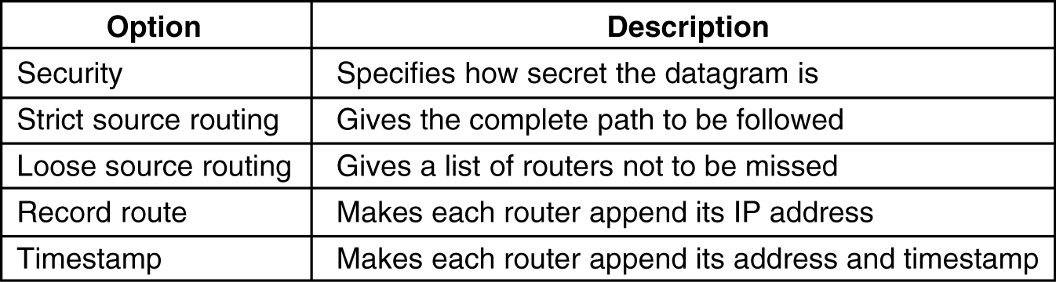
Internet Protocol: IPv4
5-54

Slide 12
Classes of IP Addresses
Class A:
Class B:
Class C:
Class D: Multicast
Class E: Research
Network
Host
Host
Host
Network
Network
Host
Host
Network
Network
Network
Host

Slide 13
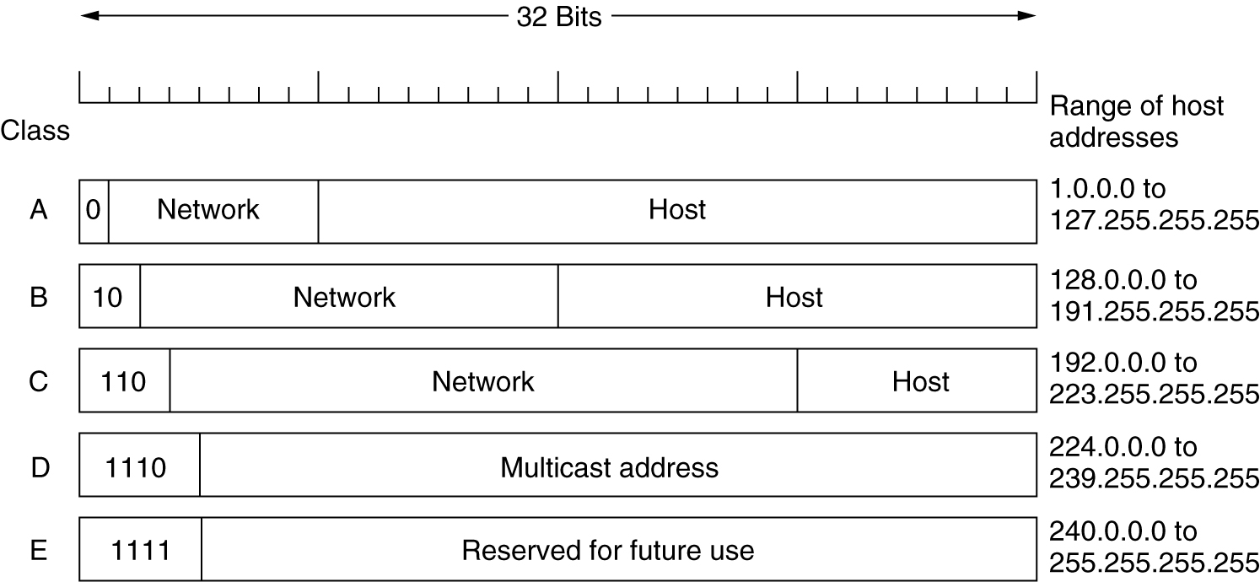
IP Addresses

Slide 14
IP Address Range
IP Address Class | IP Address Range (First Octet decimal value)
Class A | 1-126(00000001 to 01111110)*
Class B | 128-191(10000000 to 10111111)
Class C | 192-223(11000000 to 11011111)
Class D | 224-239(11100000 to 11101111)
Class E | 240-255(11110000 to 11111111)
*127 (011111111) is a Class A address reserved for loopback testing and cannot be assigned to a network.

Slide 15
Problem 1
Given the network address 17.0.0.0, find the class, the block, and the range of the addresses.
Solution
The class is A because the first byte is between 0 and 126.
The block has a netid of 17.
The addresses range from 17.0.0.1 to 17.255.255.254.

Slide 16
Problem 2
Given the network address 132.21.0.0, find the class, the block, and the range of the addresses.
Solution
The class is B because the first byte is between 128 and 191.
The block has a netid of 132.21.
The addresses range from 132.21.0.1 to 132.21.255.254.

Slide 17
Problem 3
Given the network address 220.34.76.0, find the class, the block, and the range of the addresses.
Solution
The class is C because the first byte is between 192 and 223.
The block has a netid of 220.34.76.
The addresses range from 220.34.76.0 to 220.34.76.255.

Slide 18
Default Subnet Mask
Class | Subnet Mask | Number of Network Bits
A | 255.0.0.0 | 8
B | 255.255.0.0 | 16
C | 255.255.255.0 | 24

Slide 19
Private IP Addresses
Class | Private Address Range
A | 10.0.0.0/8 to 10.255.255.255/8
B | 172.16.0.0 /12 to 172.31.255.255/12
C | 192.168.0.0/16 to 192.168.255.255/16

Slide 20



Subnetting / CIDR / VLSM
Subnet mask specifies which network the host participates in
E.g. 10.0.0.0/16, means that the network is 10.1.0.0, 10.2.0.0, 10.3.0.0, until 10.255.0.0.
10.3.0.0
10.4.0.0
…...
10.0.0.0
10.1.0.0
10.2.0.0
Before subnetting
After subnetting
20

Slide 21
Subnetting / CIDR / VLSM
To calculate the number of subnets available on a network number, use 2^{S}, where S=the number of subnet bits.
To calculate the number of hosts available on a network number, use 2^{N}–2, where N=the number of host bits.

Slide 22
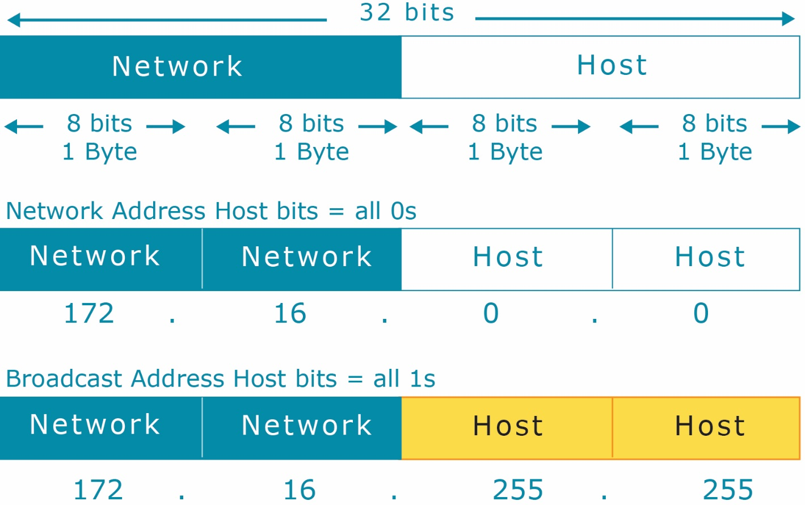
Reserved Address - Network and Broadcast

Slide 23
Subnet Mask Bits
0 0 0 0 0 0 0 0 = 0
1 0 0 0 0 0 0 0 = 128
1 1 0 0 0 0 0 0 = 192
1 1 1 0 0 0 0 0 = 224
1 1 1 1 0 0 0 0 = 240
1 1 1 1 1 0 0 0 = 248
1 1 1 1 1 1 0 0 = 252
1 1 1 1 1 1 1 0 = 254
1 1 1 1 1 1 1 1 = 255

Slide 24
Problem 4
A small organization is given a block with the beginning address and the prefix length 205.16.37.24/29
Find the following
a) Number of subnets and hosts per subnet
b) Network ID and Broadcast ID of each subnet
c) First and Last ID of each subnet

Slide 25
Problem 5
If a company needs 6 subnets with a minimum of 19 PCs per subnet, and the given IP Address is 192.168.1.0, what subnet mask should I use?

Slide 26
Internet Protocol: IPv6
Initial motivation:
32-bit address space soon to be completely allocated
Additional motivation:
header format helps speed processing/forwarding
header changes to facilitate QoS
IPv6 datagram format:
Fixed length 40-byte header
fragmentation not allowed

Slide 27
IP Version 6 Goals
Support billions of hosts
Reduce routing table size
Simplify protocol
Better security
Attention to type of service
Aid multicasting
Roaming host without changing address
Allow future protocol evolution
Permit coexistence of old, new protocols. . .

Slide 28
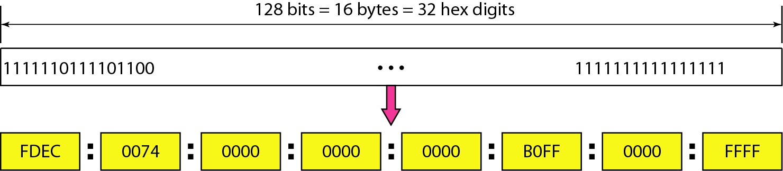
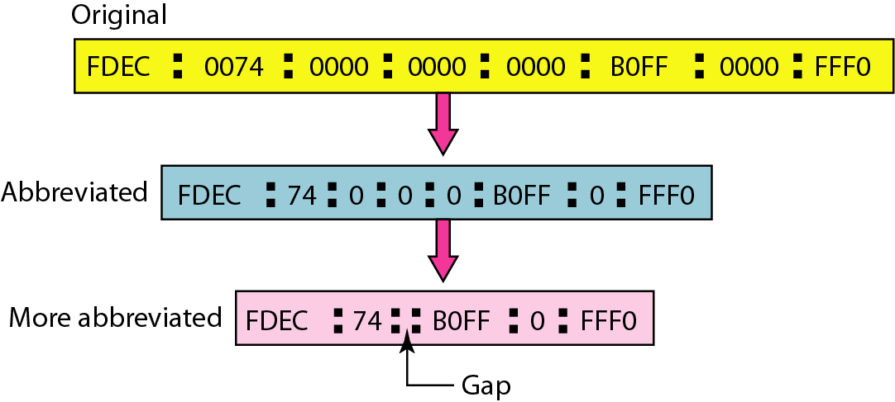
Internet Protocol: IPv6
Above abbreviation is allowed only once per address.

Slide 29
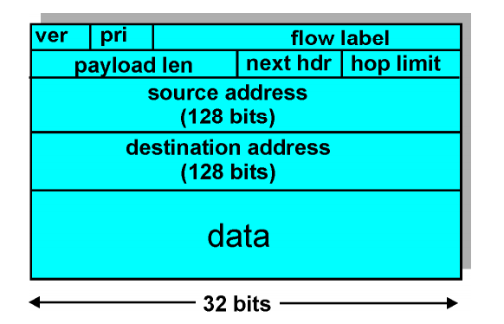
Internet Protocol: IPv6
Priority: identify priority among datagrams
Flow Label: identify datagrams in same ‘flow’
Next Header: identify upper layer protocol for data

Slide 30
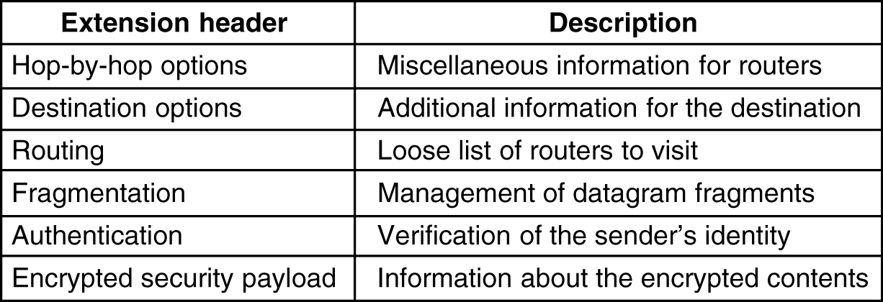
IPv6 Extension Headers
5-69

Slide 31
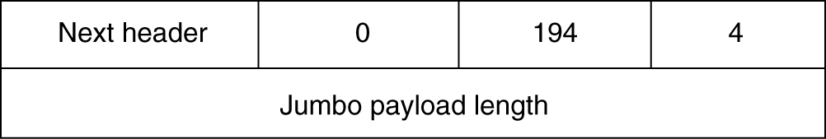
IPv6 Extension Headers
Hop-by-hop extension header for large datagrams (jumbograms)

Slide 32
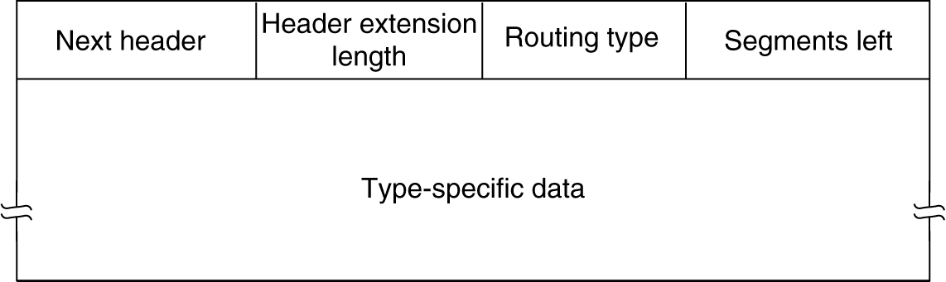
IPv6 Extension Headers (Routing)

Slide 33
Unit 2: NETWORK LAYER
Sub netting
Classless Inter-Domain Routing (CIDR)
Network Address Translation (NAT)
Internet Control Message Protocol (ICMP)

Slide 34
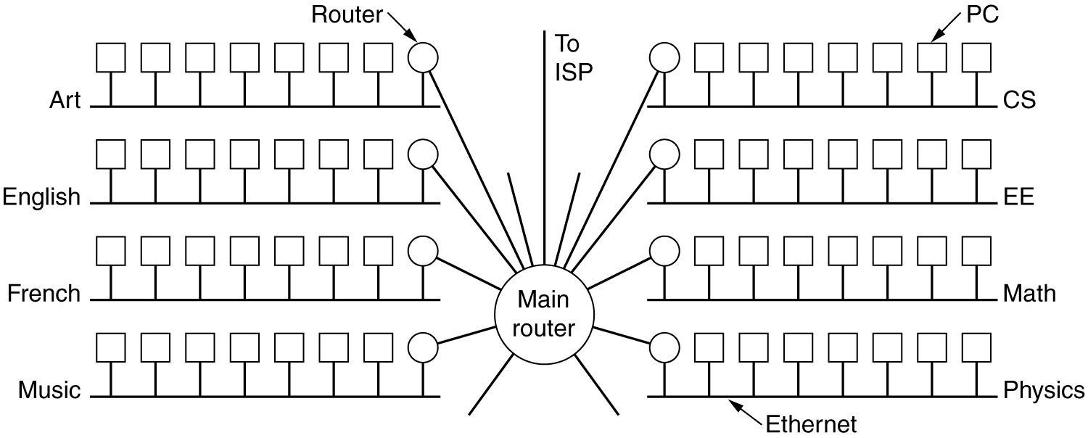
Subnets
LAN: Campus network for various departments

Slide 35
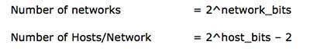
The number of networks and the number of hosts per class can be derived by this formula:
-When calculating hosts' IP addresses, 2 IP addresses are decreased because they cannot be assigned to hosts, i.e. the first IP of a network is network number and the last IP is reserved for Broadcast IP.

Slide 36
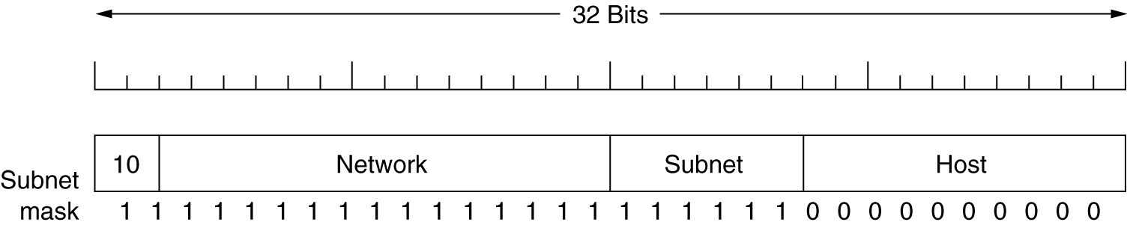
Subnets cont..
Class B network: 64 subnets

Slide 37
Classful Addressing (Cntd.)
A company is granted the site address 201.70.64.0 (class C). The company needs six subnets. Design the subnets.
Solution
The number of 1s in the default mask is 24 (class C).

Slide 38
The company needs six subnets. This number 6 is not a power of 2.The next number that is a power of 2 is 8(23).We need 3 more 1s in the sub netmask. The total number of 1s in the subnet mask is 27(24+3).
The total number of 0s is5(32-27).The mask is
11111111 11111111 11111111 11100000
or
255.255.255.224
The number of subnets is 8.
The number of addresses in each subnet is2^5(5is the number of 0s)or32.

Slide 39
An organization is granted the block 130.34.12.64/26.The organization needs to have four subnets. What are the subnet addresses and the range of addresses for each subnet?
Solution
The suffix length is 6.This means the total number of addresses in the block is 64(26).If we create four subnets,each subnet will have 16 addresses.

Slide 40
Letusfirstfindthesubnetprefix(subnetmask).Weneedfoursubnets,whichmeansweneedtoaddtwomore1stothesiteprefix.Thesubnetprefixisthen/28.
Subnet1:130.34.12.64/28to130.34.12.79/28.
Subnet2:130.34.12.80/28to130.34.12.95/28.
Subnet3:130.34.12.96/28to130.34.12.111/28.
Subnet4:130.34.12.112/28to130.34.12.127/28.

Slide 41
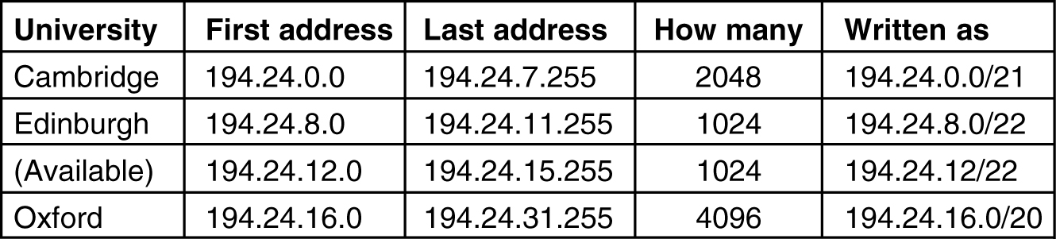
CIDR – Classless Inter Domain Routing
IP address assignments
5-59

Slide 42
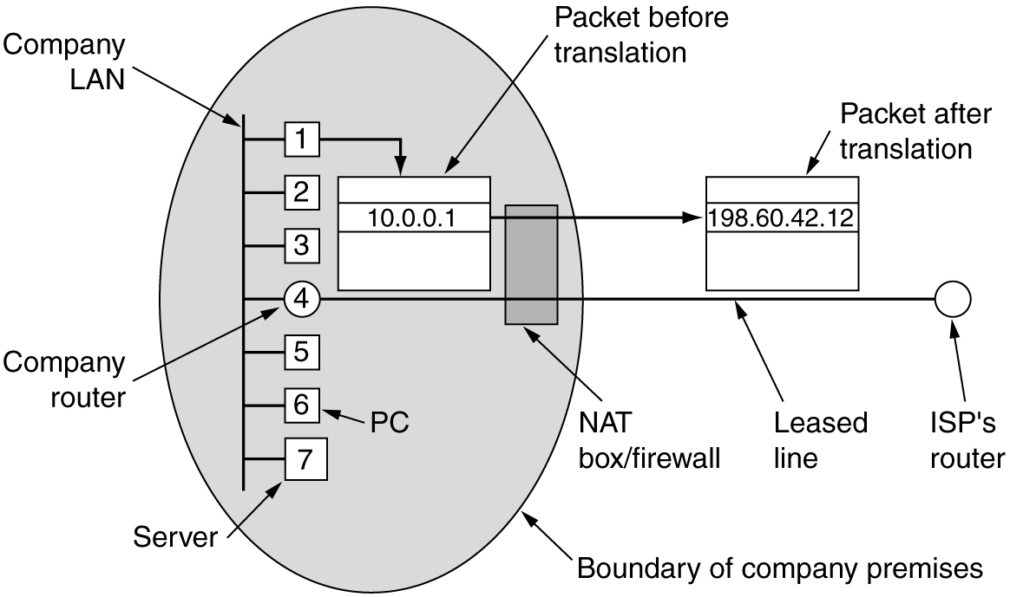
NAT – Network Address Translation
NAT: Placement and operation

Slide 43
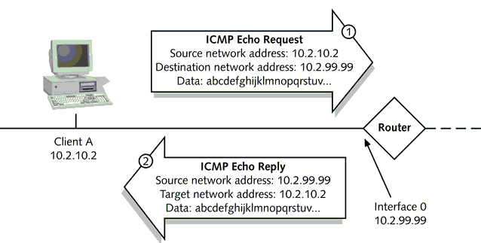
Internet Control Message Protocols
ICMP’s most common uses are testing and troubleshooting.
Two of the most well-known utilities, PING and TRACEROUTE, rely on ICMP to perform connectivity tests and path discovery.

Slide 44
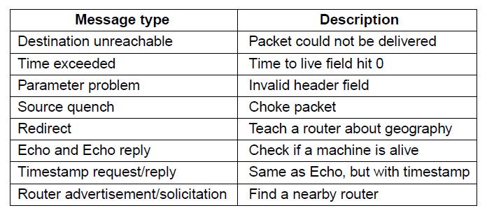
Internet Control Message Protocols
The principal ICMP message types.

Slide 45
Routing Algorithm
Network Layer responsible for deciding on which output line to transmit an incoming packet.
For virtual circuit subnets:
routing decision is made ONLY at set up
Algorithm properties:
correctness, simplicity, robustness, stability, fairness, optimality and scalability

Slide 46
Internetwork Routing
Routing Classification
Adaptive Routing
based on current measurements
of traffic and/or topology.
Non-Adaptive Routing
routing computed in advance and off-line

Slide 47
Internetwork Routing
Adaptive Routing
Centralized
Distributed
Isolated
[IGP]
Intradomain routing
[EGP]
Interdomain routing
Interior
Gateway Protocols
[BGP,IDRP]
Exterior
Gateway Protocols
Distance Vector routing
Link State routing
[RIP]
[OSPF,IS-IS,PNNI]

Slide 48
Internetwork Routing
Non - Adaptive Routing
flooding
Static Routing
Pure flooding
Selective flooding

Slide 49
Flooding
Pure flooding :: every incoming packet to a node is sent out on every outgoing line.
Obvious adjustment – do not send out on arriving link (assuming full-duplex links).
The routing algorithm can use a hop counter (e.g., TTL) to dampen the flooding.
Selective flooding :: only send on those lines going “approximately” in the right direction.

Slide 50
Shortest Path Routing
Dijkstra’s Algorithm
What does it mean to be the shortest (or optimal) route?
Choices:
Minimize the number of hops along the path.
Minimize mean packet delay.
Maximize the network throughput.

Slide 51
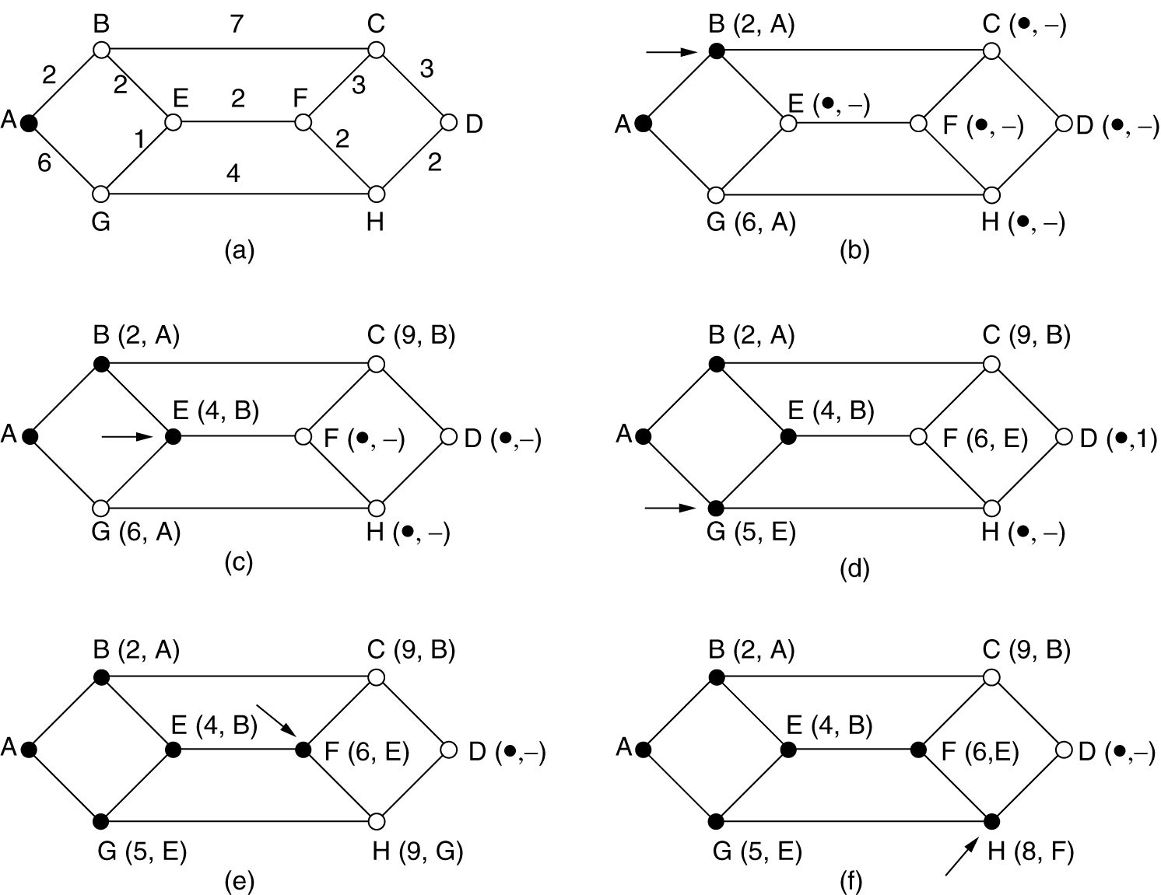
Dijkstra’s Algorithm Shortest Path Routing
The first 5 steps used in computing the shortest path from A to D. The arrows indicate the working node.

Slide 52
Internetwork Routing
Adaptive Routing
Centralized
Distributed
Isolated
[IGP]
Intradomain routing
[EGP]
Interdomain routing
Interior
Gateway Protocols
[BGP,IDRP]
Exterior
Gateway Protocols
Distance Vector routing
Link State routing
[RIP]
[OSPF,IS-IS,PNNI]

Slide 53
Adaptive Routing
Basic functions:
Measurement of pertinent network data.
Forwarding of information to where the routing computation will be done.
Compute the routing tables.
Convert the routing table information into a routing decision and then dispatch the data packet.

Slide 54
Distance Vector Routing
Information kept by DV router
each router has an ID
associated with each link connected to a router, there is a link cost (static or dynamic) the metric issue!
Distance Vector Table Initialization
Distance to itself = 0
Distance to ALL other routers = infinity number

Slide 55
Distance Vector Algorithm
Router transmits its distance vector to each of its neighbors.
Each router receives and saves the most recently received distance vector from each of its neighbors.
A router recalculates its distance vector when:
It receives a distance vector from a neighbor containing different information than before.
It discovers that a link to a neighbor has gone down (i.e., a topology change).
The DV calculation is based on minimizing the cost to each destination.

Slide 56
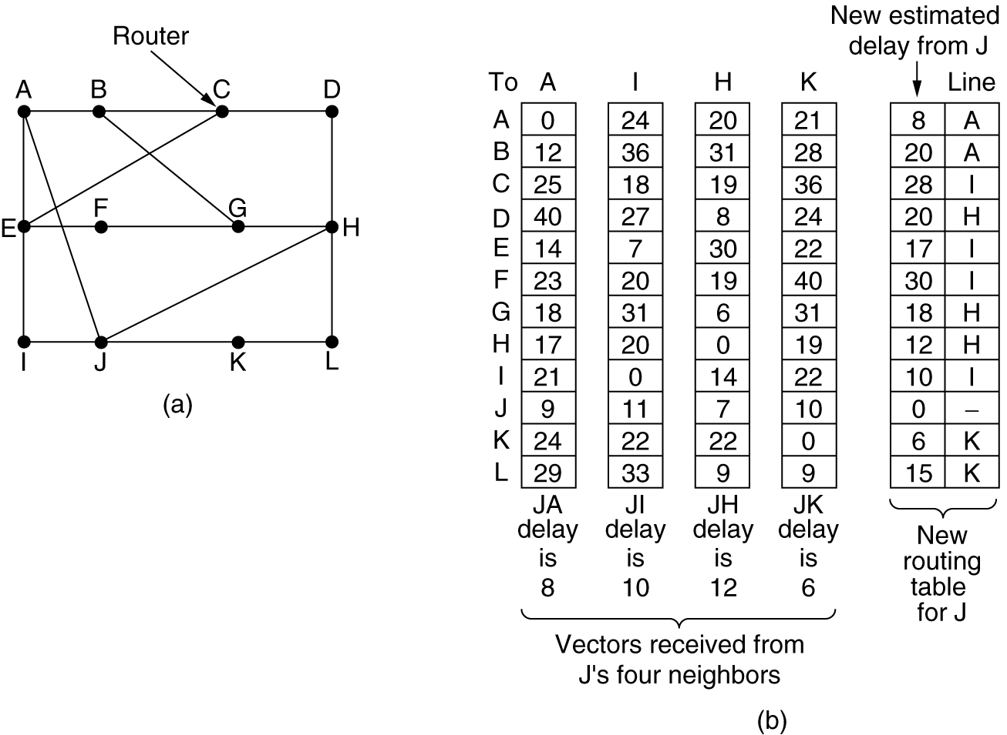
Distance Vector Routing
.(a) A subnet. (b) Input from A, I, H, K, and the new routing table for J.

Slide 57
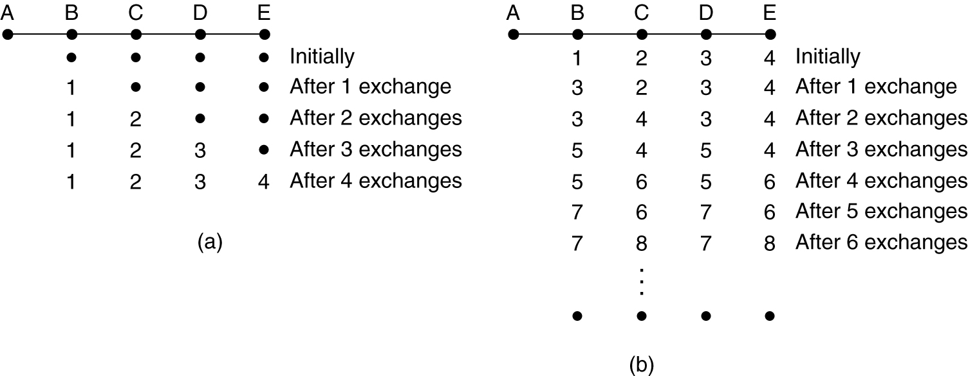
The count-to-infinity problem
Count to ∞

Slide 58
Link State Algorithm
Each router must do the following:
Discover its neighbors, learn their network address.
Measure the delay or cost to each of its neighbors.
Construct a packet telling all it has just learned.
Send this packet to all other routers.
Compute the shortest path to every other router.

Slide 59
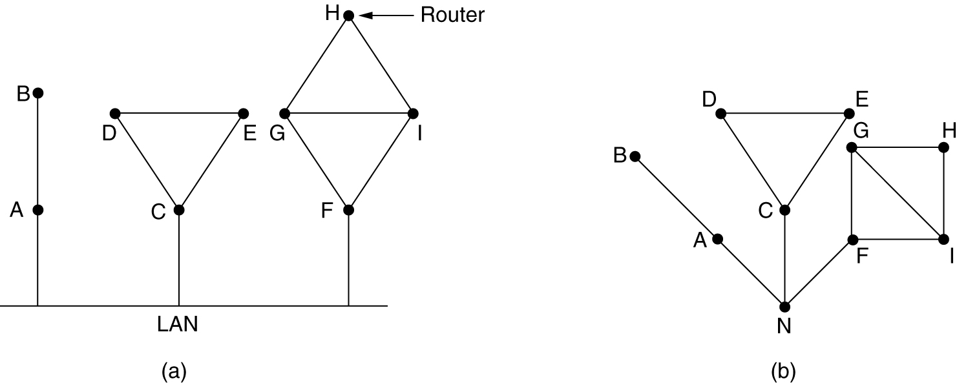
Learning about the Neighbors
(a) Nine routers and a LAN. (b) A graph model of (a).

Slide 60
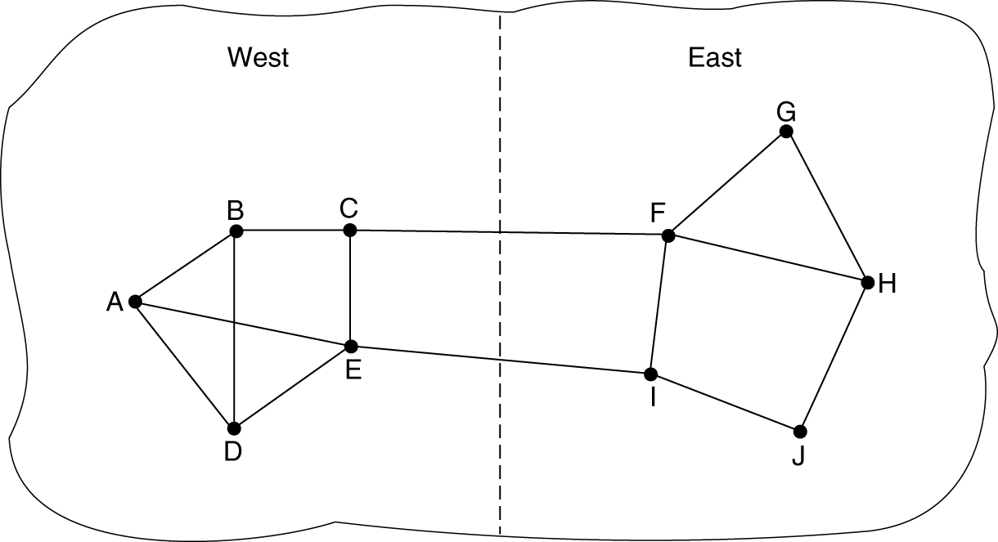
Measuring Line Cost
A subnet in which the East and West parts are connected by two lines.

Slide 61
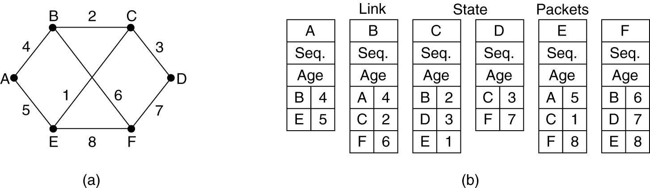
Building Link State Packets
(a) A subnet. (b) The link state packets for this subnet.

Slide 62
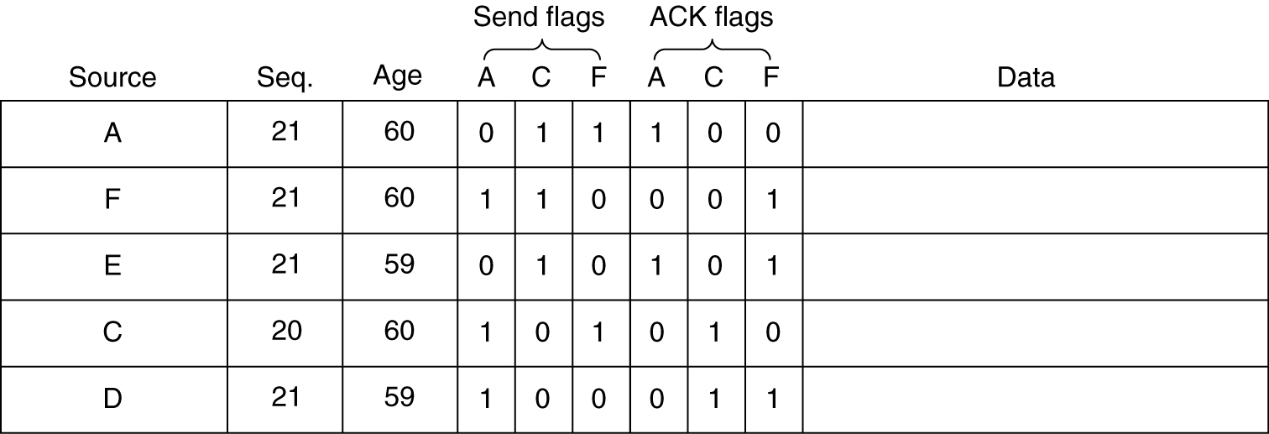
Distributing the Link State Packets
The packet buffer for router B in the previous slide

Slide 63
Routing Information Protocol (RIP)
A simple intra domain protocol
Straightforward implementation of Distance Vector Routing
Each router advertises its distance vector every 30 seconds (or whenever its routing table changes) to all of its neighbors
RIP always uses 1 as link metric
Maximum hop count is 15, with “16” equal to “∞”
Routes are timeout (set to 16) after 3 minutes if they are not updated

Slide 64
RIPv2
RIPv2 is an extension of RIPv1:
Subnet masks are carried in the route information
Authentication of routing messages
Route information carries next-hop address
Exploits IP multicasting
Extensions of RIPv2 are carried in unused fields of RIPv1 messages

Slide 65
RIP Messages
This is the operation of RIP in routed. Dedicated port for RIP is UDP port 520.
Two types of messages:
Request messages
used to ask neighboring nodes for an update
Response messages
contains an update

Slide 66
Routing with RIP
Initialization: Send a request packet (command = 1, address family=0..0) on all interfaces:
RIPv1 uses broadcast if possible,
RIPv2 uses multicast address 224.0.0.9, if possible
requesting routing tables from neighboring routers
Request received: Routers that receive above request send their entire routing table
Response received: Update the routing table
Typically, there is a routing daemon (routed) that is an application layer process that provides access to routing tables.

Slide 67
Routing with Rip Cont.
Regular routing updates: Every 30 seconds, send all or part of the routing tables to every neighbor in an response message
Triggered Updates: Whenever the metric for a route change, send entire routing table.
If a router does not hear from its neighbor once every 180 seconds, the neighbor is deemed unreachable.

Slide 68
Security
Issue: Sending bogus routing updates to a router
RIPv1: No protection
RIPv2: Simple authentication scheme

Slide 69
RIP Problems
RIP takes a long time to stabilize
Even for a small network, it takes several minutes until the routing tables have settled after a change
The maximum path in RIP is 15 hops

Slide 70
Open Shortest Path First(OSPF)
Provides for authentication of routing messages.
8-byte password designed to avoid misconfiguration.
Provides additional hierarchy
Domains are partitioned into areas.
This reduces the amount of information transmitted in packet.
Provides load-balancing via multiple routes.

Slide 71
Open Shortest Path First(OSPF)
OSPF runs on top of IP, i.e., an OSPF packet is transmitted with IP data packet header.
Uses Level 1 and Level 2 routers
Has: backbone routers, area border routers, and AS boundary routers

Slide 72
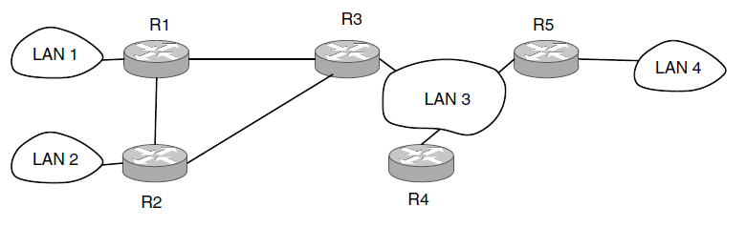
OSPF—An Interior Gateway Routing Protocol (1)
An autonomous system

Slide 73
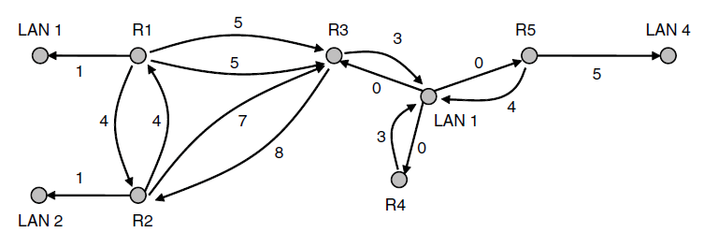
OSPF—An Interior Gateway Routing Protocol (2)
A graph representation of the previous slide.

Slide 74
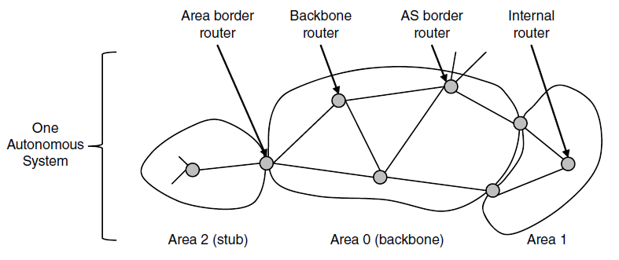
OSPF—An Interior Gateway Routing Protocol (3)
The relation between ASes, backbones, and areas in OSPF.

Slide 75
OSPF Terminology
Internal router :: a level 1 router.
Backbone router :: a level 2 router.
Area border router (ABR) :: a backbone router that attaches to more than one area.
AS border router :: (an interdomain router), namely, a router that attaches to routers from other ASs across AS boundaries.

Slide 76
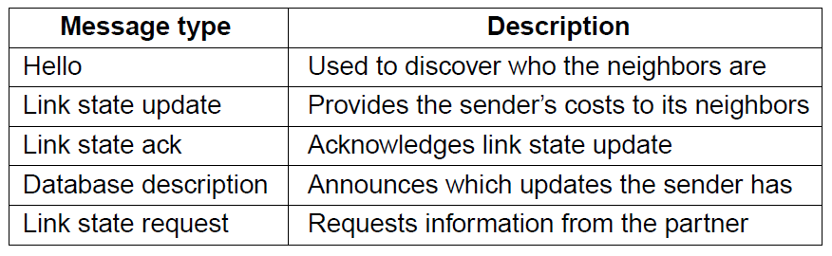
OSPF—An Interior Gateway Routing Protocol (4)
The five types of OSPF messages

Slide 77
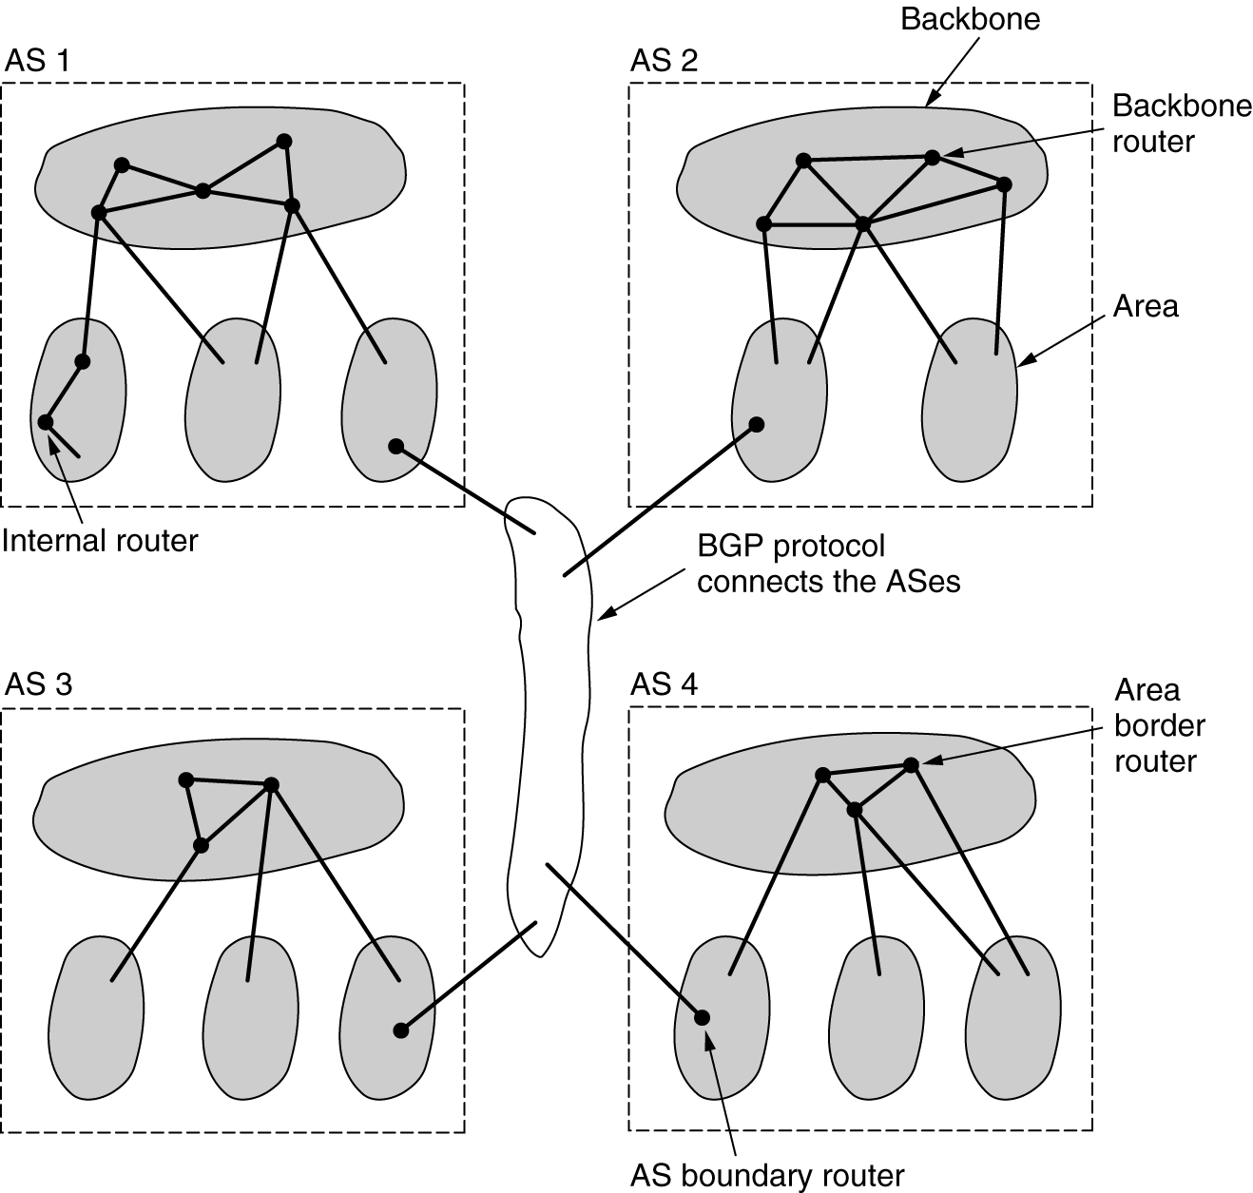
OSPF
The relation between ASes, backbones, and areas in OSPF.

Slide 78
Border Gateway Protocol (BGP)
Current version is BGP-4.
BGP assumes the Internet is an arbitrary interconnected set of AS’s.
In interdomain routing the goal is to find ANY path to the intended destination that is loop-free. The protocols are more concerned with reachability than optimality.

Slide 79
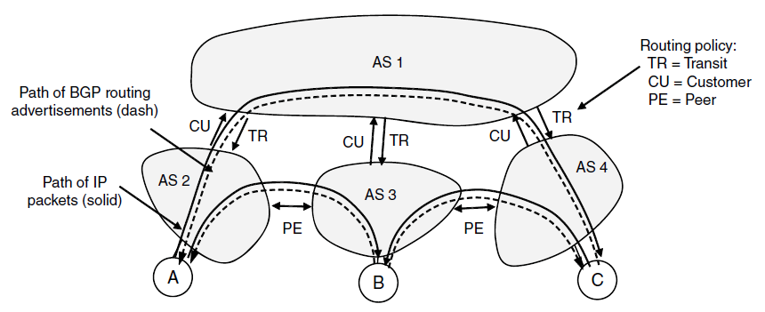
BGP—The Exterior Gateway Routing Protocol (2)
Routing policies between four Autonomous Systems

Slide 80
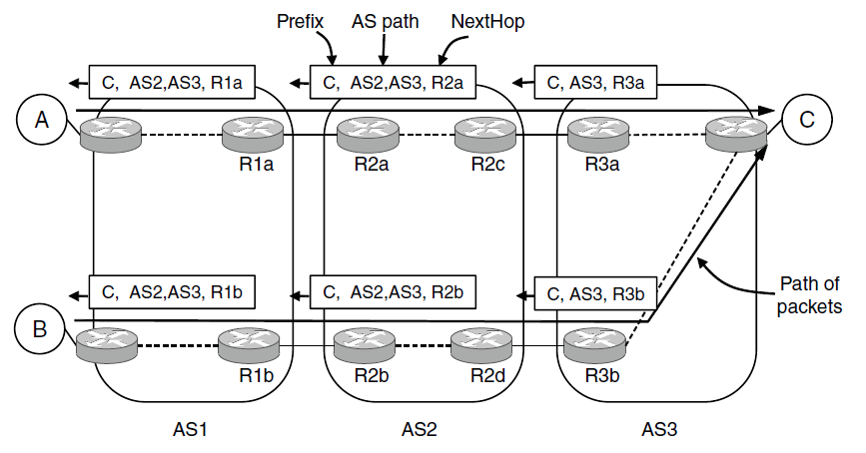
BGP—The Exterior Gateway Routing Protocol (3)
Propagation of BGP route advertisements

Slide 81
Congestion Control
Too many packets present in the network
packet delay and loss
Congestion occurs within the network
Affects the network layer
it must ultimately determine what to do with the excess packets.
The network and transport layers share the responsibility for handling congestion
Congestion at the network layer is related to two issues
throughput
delay

Slide 82
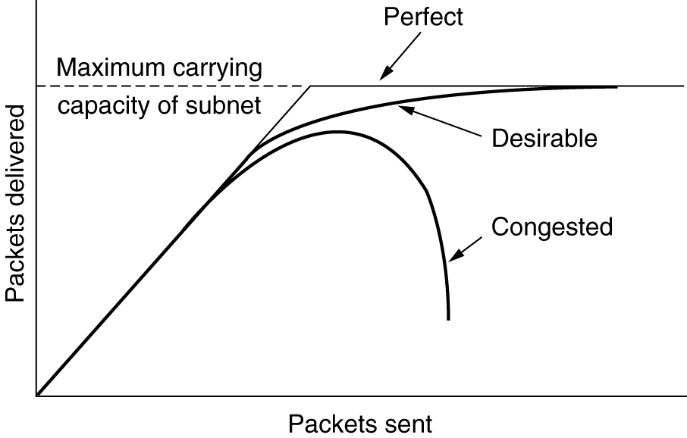
Congestion
When too much traffic is offered, congestion sets in and performance degrades sharply.

Slide 83
Congestion Control Algorithms
General Principles of Congestion Control
Congestion Prevention Policies
Congestion Control in Virtual-Circuit Subnets
Congestion Control in Datagram Subnets

Slide 84
General Principles of Congestion Control
Monitor the system .
detect when and where congestion occurs.
Pass information to where action can be taken.
Adjust system operation to correct the problem.

Slide 85
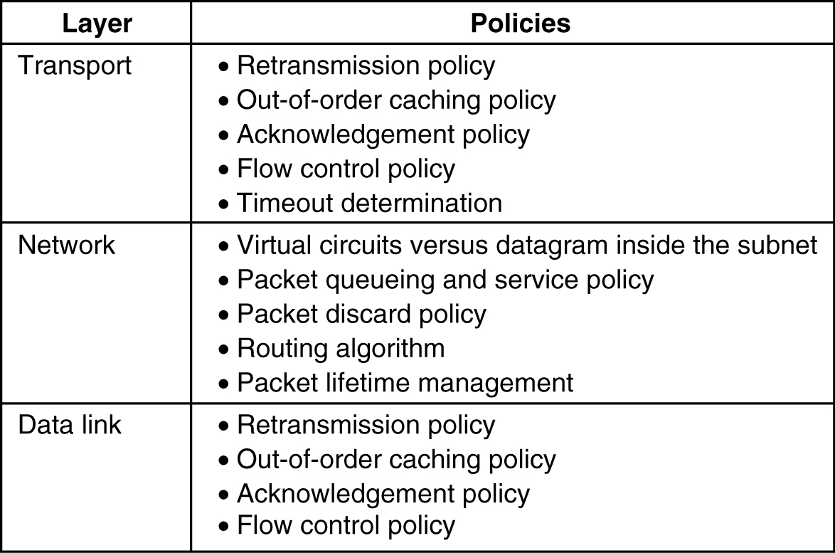
Congestion Prevention Policies

Slide 86
Quality of Service
Overprovisioning
Buffering
Traffic Shaping
The Leaky Bucket Algorithm
The Token Bucket Algorithm
Fragmentation

Slide 87
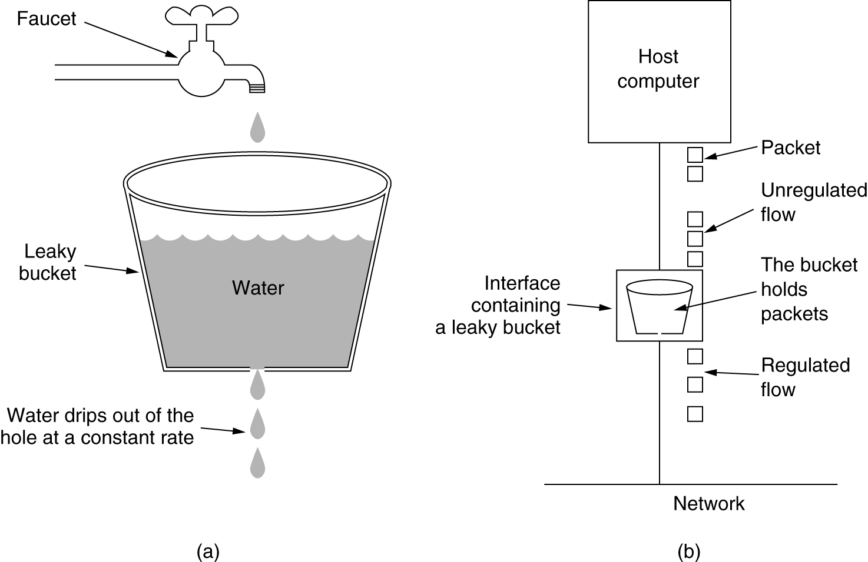
The Leaky Bucket Algorithm
(a) A leaky bucket with water. (b) a leaky bucket with packets.

Slide 88
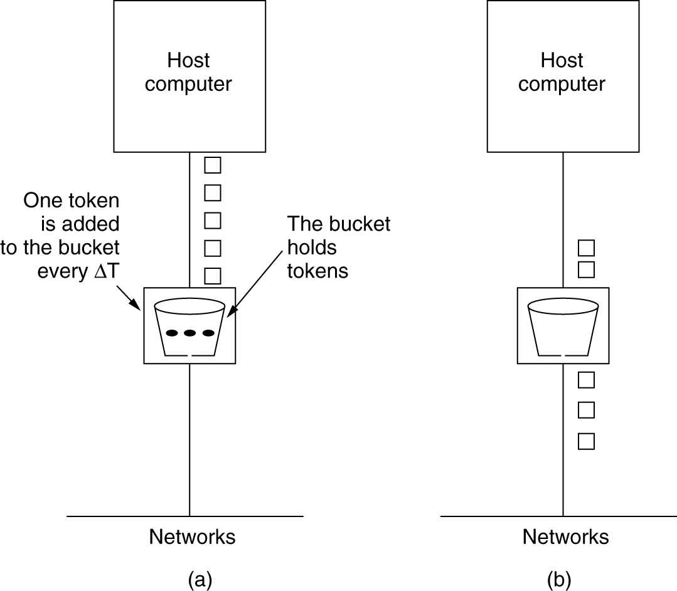
The Token Bucket Algorithm
5-34
(a) Before. (b) After.

Slide 89
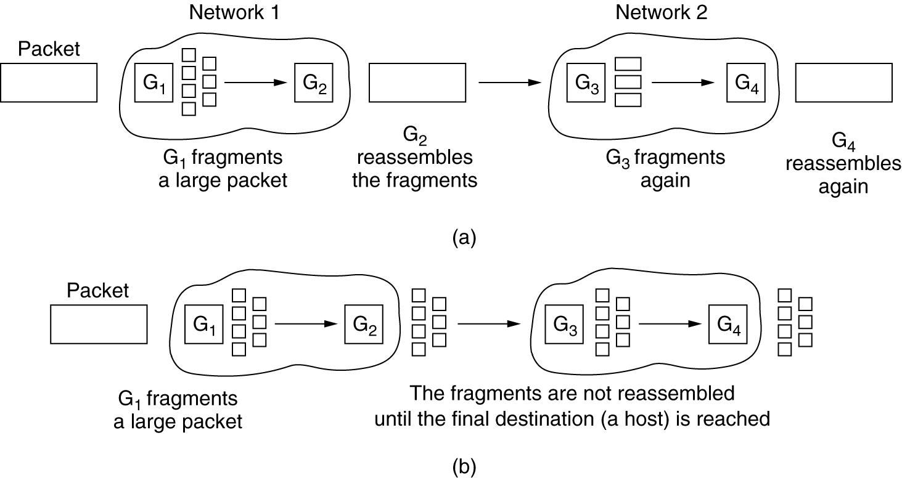
Fragmentation
(a) Transparent fragmentation. (b) Nontransparent fragmentation.

Slide 90
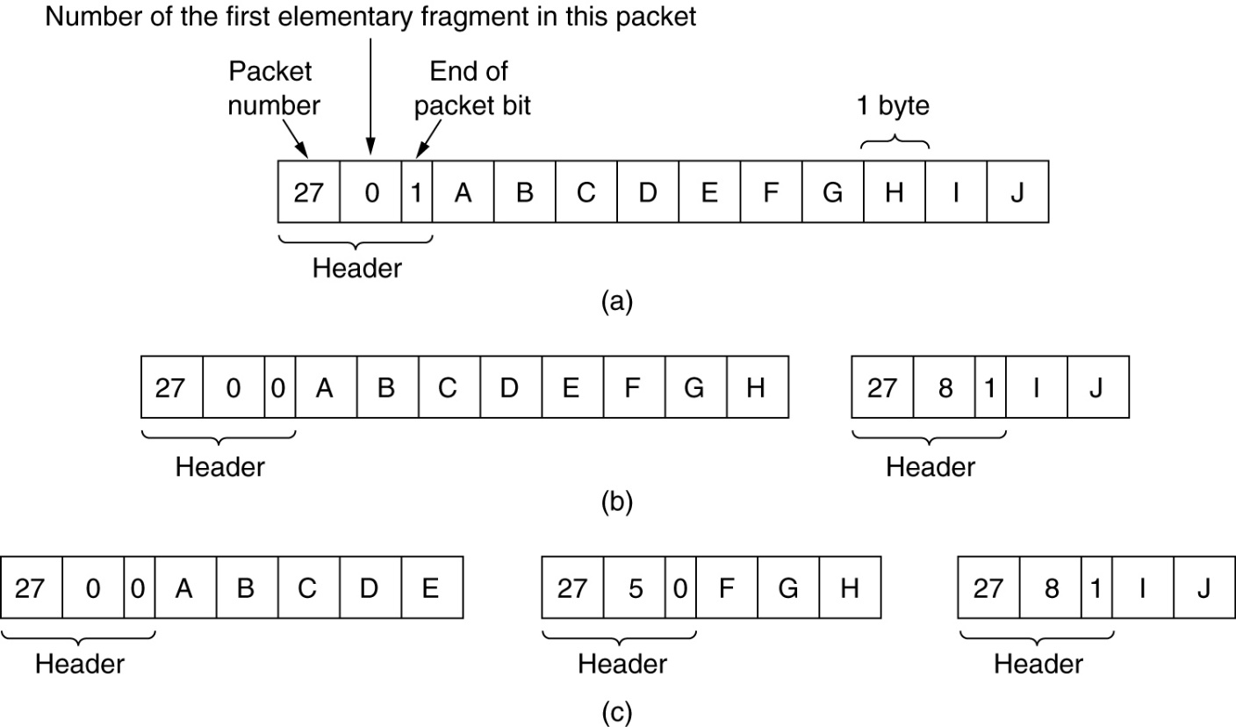
Fragmentation

